Slide 1

Blockchain
Prof. Sunitha R
Department of Computer Science and Engineering

Slide 2


Blockchain
Proof of Capacity (PoC)/Proof of Space (PoSpace) and Proof of Burn
Prof. Sunitha R
Department of Computer Science and Engineering

Slide 3
Blockchain
Consensus Algorithm – Proof of Capacity / Proof of Space
Proof-of-Capacity, which has also been referred to as Proof-of-Space, was first proposed in 2013 in the Proofs of Space whitepaper.
Proof of Capacity (PoC) is a consensus algorithm used in Blockchains that allows miners in the network to mine for tokens with the available space they have on their hard drive.

Slide 4
Blockchain
Proof of Space
PoSpace in Cloud
PoSpace is also being used in cloud storage technologies in which the peers contribute their free disk space and get service proportionately.
Peers can also get paid if they let their free space to be used by peers that need more space.
Eg: Storj is a PoSpace based cloud storage

Slide 5
Blockchain
Consensus Algorithm – Proof of Capacity / Proof of Space
Collaborative Consensus
Farmers
Nodes that are securing transaction.
Allocate non-trivial amount of memory or disk space
Use leftover memory
Farmers not fighting to secure blocks.
Green and scalable

Slide 6
Blockchain
Consensus Algorithm – Proof of Capacity / Proof of Space
PoC miners use a 2-step system
Plotting
Plotting consists of creating a random solution, known as a plot, through the Shabal cryptographic algorithm and storing it on a miner’s hard drive.
Mining
Mining consists of miners reaching the solution, and whoever reaches it first, gets to mine the next block.

Slide 7
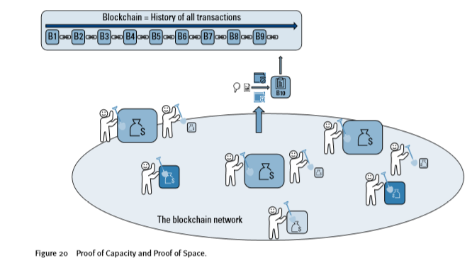
Blockchain
Proof of Capacity / Proof of Space

Slide 8
Blockchain
Proof of Capacity / Proof of Space
Pros
Uses wasted hardware space.
Environmentally friendly
Cons
New and not tested.
PoSpace and PoC are used by Burstcoin, Chia and SpaceMint

Slide 9
Blockchain
Proof of Burn
Non competitive
Validated by elected nodes.
User pays the fee by burning some cryptocurrency
Sending cryptocurrency to an address where it can never be retrieved.
To secure things like land titles, birth records and data feeds on IoT devices.

Slide 10
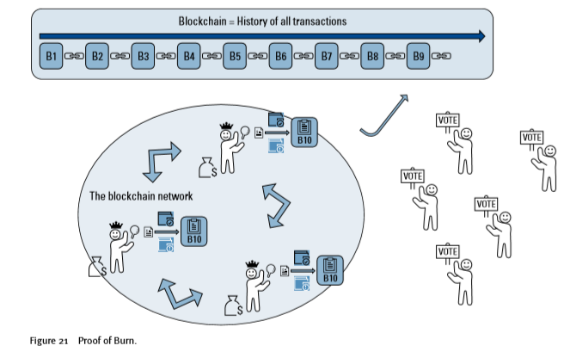
Blockchain
Proof of Burn (PoB)

Slide 11

Blockchain
Coinburn
Miners should show proof that they have burned some coins
Sent them to a verifiably un-spendable address

Slide 12
Blockchain
Proof of Burn (PoB)
Pros
Cheap to use
Scalable to all types of applications.
Cons
Centralization.
Limited functionality
Proof of Burn is used by Slimcoin, TGCoin and Factom.

Slide 13
Blockchain
Consensus Algorithm
PoW
PoS
PoB
Do some work to mine a new block
Consumes physical resources, like CPU power and time
Power hungry
Acquire sufficient stake to mine a new block
Consumes no external resource, but participate in transactions
Power efficient
Burn some wealth to mine a new block
Consumes virtual or digital resources, like the coins
Power efficient

Slide 14
Blockchain
Consensus Algorithm- Reference
https://www.burst-coin.org/features/proof-of-capacity/
https://ieeexplore.ieee.org/document/8822381
https://ieeexplore.ieee.org/document/5158550
https://ieeexplore.ieee.org/document/8756129

Slide 15
THANK YOU
Prof. Sunitha R
Department of Computer Science and Engineering
sunithar@pes.edu

